Slide 1




Team Name: ZVEZDA
Theme: Smart City
Team Member 1 Name : Sahil Lalwani
College name : LNCT
Contact Detail : 8770942895
Role in Solution Development : Web Development
Team Member 2 Name : Kartik Bhardwaj
College name : LNCT
Contact Detail : 8000240334
Role in Solution Development : AIML,Figma
Team Member 3 Name : Subrat Kumar
College name : LNCT
Contact Detail : 8004207196
Role in Solution Development : Web Development
Team Member 4 Name : Mitesh Patidar
College name : LNCT
Contact Detail : 9399609619
Role in Solution Development : Figma, Research Team

Slide 2

Introducing: hoodbuddy explore your ‘hood’,buddy!
Introducing HoodBuddy, the smart assistant app designed to revolutionize your city experience. Whether you're a local looking to discover hidden treasures in your neighborhood or a traveler seeking to navigate unfamiliar streets with ease, HoodBuddy is here to simplify and enhance every aspect of urban living.
HoodBuddy emerges as your trusted guide, empowering you to navigate with ease, discover hidden gems, and connect with the heartbeat of your city.

Slide 3
What problems are we solving with hoodbuddy ?
Limited Local Knowledge: Many people, especially newcomers to a city or tourists, struggle to find their way around local neighborhoods and may miss out on hidden gems or essential services.
Lack of Real-Time Information: Without access to real-time information, individuals may face delays or inconveniences when trying to locate nearby services or navigate through the city efficiently.
Safety Concerns: In unfamiliar areas, safety can be a significant concern. HoodBuddy helps users explore neighborhoods confidently by providing insights into safety ratings, crime statistics, and emergency services.
Wasted Time and Resources: Without access to tools that optimize city living, individuals may waste time and resources traveling inefficiently.
Decision Fatigue: Big Cities offer a lot of options for dining, entertainment, and leisure activities, leading to decision fatigue. HoodBuddy simplifies decision-making by curating personalized recommendations based on user preferences and interests.

Slide 4
Key features of hoodbuddy
Neighborhood Exploration
Personalized Recommendations
Chatbot Assistance (PAL)
Safety Insights
Healthcare Facility Recommendations
Rental Services Information
Food Recommendations
Banking Services Information
Market Recommendations
Hotel Recommendations
Leisure Activities

Slide 5
How will we create the dataset ?
Open Data Platforms: We will use Open Data that is authenticated by the ministry of Housing and Urban Affairs, like the websites Opencity.in and Smartcities.data.gov.in.
Previously Surveyed Data: We will use previously surveyed authentic data using websites like data.world, link.springer.
Pop up: By Conducting online surveys through Pop up links, Embedded links on social media platforms and Websites, we can collect raw data.
Community Partnership: We can collect data from local public by placing QR codes which are distributed by shopkeepers.

Slide 6
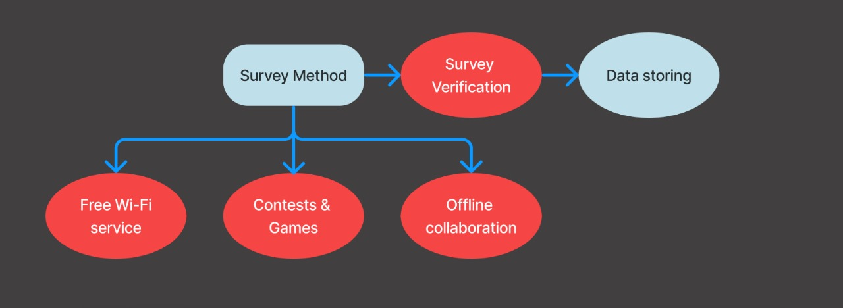
Free wifi !!!
Free Wi-Fi: Whenever a person will try to access our free Wifi, He/She will be directed to a Survey based authentication page where the user will have to give a short survey and verification test and then the user can access the free Wifi. The survey will contain 4-5 simple questions related to the locality and nearby places. As an example, To get more data we can redirect the user to the survey page after he/she has used Wifi for 30 minutes, he/she will have to repeat the same process to get 30 minutes of free wifi again.

Slide 7
Working of hoodbuddy
User Registration: Users download the HoodBuddy app from the app store and create an account. They provide basic information such as their location, preferences, and interests to personalize their experience.
Neighborhood Exploration: Upon opening the app, users are greeted with a map interface showcasing their current location. They can explore nearby neighborhoods, landmarks, and points of interest using intuitive navigation controls.
Personalized Recommendations: Based on the user's preferences and past interactions, HoodBuddy provides personalized recommendations for local attractions, restaurants, events, and businesses. Users can discover hidden gems and popular hotspots tailored to their interests.
Safety Insights: HoodBuddy enhances user safety by providing insights into neighborhood safety ratings, crime statistics, and the locations of nearby emergency services. Users can make informed decisions about their surroundings and navigate with confidence.

Slide 8
Chatbot Assistance(PAL): PAL stands for “Personalised Accurate Loyal” chatbot. Within the HoodBuddy app, users have access to a chatbot feature accessible through a dedicated chat interface. Users can interact with the chatbot using natural language to ask questions, seek recommendations, or request assistance related to city exploration, neighborhood discovery, and local services.
Information Retrieval: The chatbot provides users with access to a wealth of information about their surroundings. Users can ask questions about local landmarks, historical sites, cultural attractions, and practical amenities like ATMs, restrooms, and parking facilities.
Feedback and Support: Users can provide feedback, report issues, or seek assistance from customer support through the chatbot feature. The chatbot handles common inquiries and escalates complex issues to human operators for resolution, ensuring prompt and efficient customer service.

Slide 9
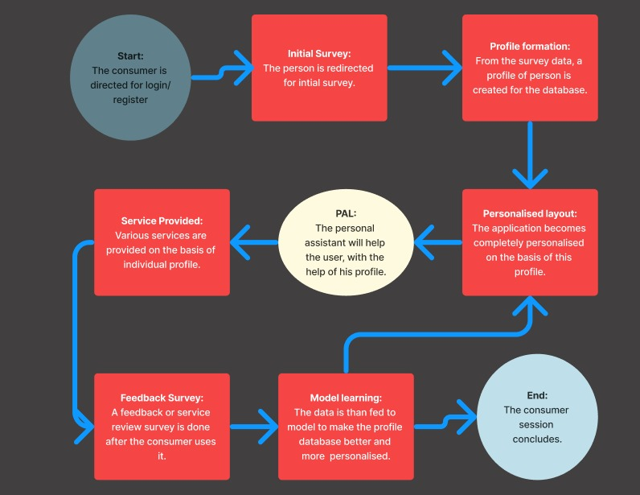
Workflow of hoodbuddy

Slide 10
Data security in hoodbuddy
Incident Response Plan: We will develop and maintain an incident response plan to effectively respond to data breaches or security incidents. Define roles and responsibilities, establish communication protocols.
End-to-End Encryption: We will implement end-to-end encryption for all user data, including personal information, location data, and communication within the app. This ensures that data remains secure and private.
Data Minimization: Collect and store only the minimum amount of data necessary for HoodBuddy's functionality. Avoid collecting unnecessary personal information and regularly review data retention policies to delete data that is no longer required.
Regular Security Audits: Conduct regular security audits and penetration testing to identify and address vulnerabilities in HoodBuddy's infrastructure, codebase, and third-party integrations.

Slide 11
Business model of hoodbuddy
HoodBuddy will generate revenue through a combination of subscription services, advertising partnerships, in-app purchases. By leveraging these revenue streams, HoodBuddy can sustainably operate and continue to provide value to users and stakeholders.
Freemium Model: HoodBuddy could adopt a freemium model where the basic version of the app is available for free, offering essential features such as neighborhood exploration and basic navigation. Users can then opt for a premium subscription to unlock advanced features such as personalized recommendations, offline access, and enhanced safety insights.
Advertising and Partnerships: HoodBuddy can generate revenue through targeted advertising and partnerships with local businesses, attractions, and events. By showcasing relevant advertisements and sponsored content within the app, HoodBuddy can create additional revenue streams while providing valuable exposure to its partners.

Slide 12
Future goals for hoodbuddy
Smart City Integration: Partner with municipal authorities and smart city initiatives to integrate HoodBuddy into the broader urban infrastructure, leveraging data analytics, and urban planning initiatives to enhance city living.
Advanced Machine Learning: Continuously improve the chatbot feature of HoodBuddy by leveraging advanced machine learning algorithms and natural language processing (NLP) techniques to provide more personalized and context-aware assistance to users.
Multilingual Support: Implement multilingual support within HoodBuddy to cater to a diverse user base and enhance accessibility for non-native speakers and international travelers.

Slide 13
Tech-stack
Web-Development:
HTML
CSS
JavaScript
BootStrap ( FrameWork)
Tools Used:
BotPress
WebFlow
VS Code
GitHub & Git
UI/UX:
Figma
API’s:
ChatGPT API
REST API

Slide 14
THANKYOU -TEAM ZVEZDA

